Slide 1
STPCON 2006
Best Practices for Managing Distributed Testing Teams
November 9, 2006

Slide 2

Presentation Topics
STPCON 2006
Overview of The Symbio Group
What is Distributed Testing?
Managing Distributed Teams
Conclusions
“Symbio’s technical team provided a great value to our global implementation capabilities.”
-- Linda Jaeckel, MasterCard --

Slide 3























Symbio is a leader in IT services and outsourcing
SYMBIO OVERVIEW
Representative Client List:
Founded in 1994
  IBM product development heritage
Number of employees: 750+
Global presence
  US – 4 offices
  International – 9 offices
  Development Centers – 4 facilities
Number of clients: 300+
  100% reference-able track record
  Manage more ODCs for US clients than any other firm in China

Slide 4
Symbio Global Software Lifecycle Solutions
SYMBIO OVERVIEW
BUILD
TEST
SCALE
GLOBALIZE
Develop Software Fast & Cost-Effectively
Reduce QA Cycle Times & Improve Efficiency
Create a Highly Flexible Global Resource Base
Extend Software Globally & Grow New Markets
Software design, development, and reengineering
Product lifecycle management solutions
Software porting and migration
Maintenance & sustaining engineering
QA planning and test design
Full spectrum testing solutions across the software lifecycle
White box / black box testing
Internationalization and localization testing
Center-of-Excellence model for global resource flexibility
Dedicated teams for software customization, integration, and deployment
Global support center for on-going technical and user support
Software internationalization
Localization into 30+ languages and locales
Software customization for international markets
Multilingual customer support solutions
In-country field support
IBM
AirMagnet
AOL
SkillSoft
FileNet
Mercedes-Benz
BMC
Amdocs
Notes:
Symbio’s service solutions span the full range of the software product life cycle. As we look at this chart, I ask you to remember that you can engage Symbio for any phase of your life-cycle, and you can move the scope of the engagement either direction, as dictated by your requirements.
We bring world class engineers to bear on developing, maintaining, or sustaining your software products.
We can also deploy some of the best testing resources available to ensure that your products fully meet your quality standards.
Where we really distinguish ourselves at Symbio, however, is our ability to move far beyond these traditional outsourcing roles. We excel at helping our clients scale by developing an extremely flexible global resource base that includes a Center of Excellence staffed by skilled technologists that are truly experts in your products and at serving your clients. These flexible teams can provide the full range of development, test and QA services along with system integration and technical support.
Often, along with leveraging global resources, our clients ask for support in providing localized product versions that can be deployed globally. Again, Symbio provides a full range of services, including Localization, Internationalization and Globalization engineering. As regional versions for East Asia become available, clients often ask us to step in to provide multi-lingual support and best in breed in region field support.
By applying our production proven processes and methodologies, we can engage with you at any point in the life cycle and we can ensure you that we will be there with excellent service as the scope of your requirements evolves.
Some of the notable clients that are taking advantage of our various services include:….

Slide 5

Global Presence
SYMBIO OVERVIEW
Symbio’s staggered time zones between labs creates an 18-hour work day for our clients…
…and enables many delivery models to fit our client’s unique project needs.
Module/Object-Based
Site A
Site B
t = 0
delivery
Phase-Based
Site A
Site B
Integrated
United States:
Los Angeles
Seattle (Development Center)
Silicon Valley
Washington DC
Asia-Pacific:
Beijing (Development Center)
Chengdu (Development Center)
Dalian
Ho Chi Minh City
Shanghai
Shenzhen
Taipei (Development Center)
Tokyo
Wuhan
Site A
Site B
Follow-the-Sun
Site A
Site B

Slide 6

Presentation Topics
STPCON 2006 Agenda
Overview of The Symbio Group
Definition
Managing Distributed Teams
Conclusions
FACT: Symbio was named one of the world’s top 20 eGlobalization innovators by International Data Corporation (IDC).

Slide 7


Definition
DISTRIBUTED TESTING
Executing Test Projects Across Multiple Teams in Separate Locations
  Typically leveraging offshore test centers
Becoming a Mainstream Process
  Reduced development costs
  Requires specialized talent
  Reduced time-to-market
  Proximity to customer/global presence
  Scalability
  Acquisitions/industry consolidation

Slide 8
Teams: Past & Present
DISTRIBUTED TESTING
Traditional Teams | Virtual Teams
Co-located members | Distributed members
Face-to-face interaction | Electronic communication
Members from the same organization | Members from different organizations
Hierarchical | Networked
Mostly informal communication | Continuous structured communication
Position authority | Process and knowledge authority
Information distribution (push) | Information access (pull)
Information on paper | Electronic information
Sharing completed work | Continuous sharing of work-in-process
Culture learned through contact | Culture learned through electronic-based communications and artifacts
Source: Grenier Ray & George Metes. Going Virtual: Moving your organization into the 21st century, Upper Saddle River, NJ: Prentice Hall, 1995

Slide 9
Presentation Topics
STPCON 2006 Agenda
Overview of The Symbio Group
Definition
Managing Distributed Teams
Conclusions
“Symbio has proven that they can scale up or down to meet our needs. Symbio has provided excellent service at reasonable rates, and the company has never failed to meet a commitment.”
-- Jonathan Smith, Microsoft --

Slide 10


Challenges
MANAGING DISTRIBUTED TEAMS
Cultural Differences
Dispersion
Lack of Bonding
Cultural Incompatibility
Leadership Problems
Trust Issues
Negative Competitiveness
Coordination Breakdown
Loss of “Communication Richness”

Slide 11
Key Management Focus Areas:
MANAGING DISTRIBUTED TEAMS
Key Project Drivers
Project Delivery Models
Methodologies
Process
Infrastructure
Collaboration Tools
Project Tools
Team Organization
Team Interaction
Team Culture
Technology
People

Slide 12
MANAGING DISTRIBUTED TEAMS
Identify Key Business Drivers
Process
Technology
People
Cost Reduction
Delivery Acceleration
Business
Drivers
Risk Mitigation /
Project Dispersion
Team Flexibility

Slide 13
MANAGING DISTRIBUTED TEAMS
Delivery Models
Process
Module/Object-Based
Cost
Site A
Technology
People
Site B
t = 0
delivery
Phase-Based
Risk Mitigation
Site A
Site B
Primary Business Driver
Integrated
Flexibility
Site A
Site B
Follow-the-Sun
Delivery Acceleration
Site A
Site B

Slide 14
MANAGING DISTRIBUTED TEAMS
Standard Methodologies & Processes
Ongoing project operations
Personnel issues
Project performance
Level of service management
Process
Project Management Processes
Technology
People
Release management
Configuration management
Security: physical, individual, logical
Asset Management Processes
Environment integrity
System testing
Acceptance testing
Production turnover
Production Management Processes
Management Oversight Processes
Audit and review project performance
Escalation processes
Project operations improvement
Continuous process improvement
SEI-CMM compliance
Continuous Improvement Processes
Notes:
Methodologies and processes must be standardized, documented and repeatable across teams

Slide 15

MANAGING DISTRIBUTED TEAMS
Monitoring
Process
Measurable Performance Indicators
  Focus on operational goals to clarify objectives
Key Guidelines for Indicators
  Focus on output, not activity
  Measure something tangible
  Keep it simple so everyone understands intuitively
  Pair opposing indicators
Technology
People

Slide 16
MANAGING DISTRIBUTED TEAMS
Infrastructure
Process
Networking Issues
  High bandwidth connections between all sites
    Private internal networks for dedicated teams
    VPNs for on-going projects
  Separate private/public networks
Platforms
  Establish consistent hardware and software platforms
  Global redundancy and synchronization
Technology
People
Notes:
Infrastructure is the most basic technology requirement

Slide 17
MANAGING DISTRIBUTED TEAMS
Collaborative Technologies
Process
Key Objectives
  Communication
  Team memory / knowledge center
  360 degree views
  Community
Technology
People
Time
Synchronous
Asynchronous
Video conferencing
Audio conference
Chat/instant messenger
E-whiteboard
Virtual reality meeting
Email
Voicemail
Groupware
Calendar/schedule
Discussion lists
Different
Place
Meetingware
Same
Source: Erran Carmel. Global Software Teams: Collaborating Across Borders and Time Zones;Prentice Hall, 1999

Slide 18



MANAGING DISTRIBUTED TEAMS
Tools Enable Management
Process
Project Management Tools Must Support
  Software configuration management
  Project status
  Notification services
  Project scheduling and tasking
  Workflow and process management
  Productivity tools
  Bug and change tracking
  Team memory and knowledge center
Technology
People
Notes:
Project tools are the “nerves” to the team’s “brains”

Slide 19
MANAGING DISTRIBUTED TEAMS
Avatar Management System
Symbio Avatar Systems
Powered by Remedy ARS
Development Methodologies
Collaborative Technologies
Project Management
Project Delivery
Asset Management
Production Control
Continuous Improvement
Design Chain Control
Process Monitoring
Escalation Management
Impact Analysis
Version Control
Well-
Managed
Projects
Resource Management
Project Staffing
Resource Training
Bug Tracking (SymTrack)
Programming Tools
Knowledge Base (SymBase)
Analysis Tools
Management Methodologies
Project Tools
Role-Based Digital Cockpits
Client View
Project Team
Project Office

Slide 20
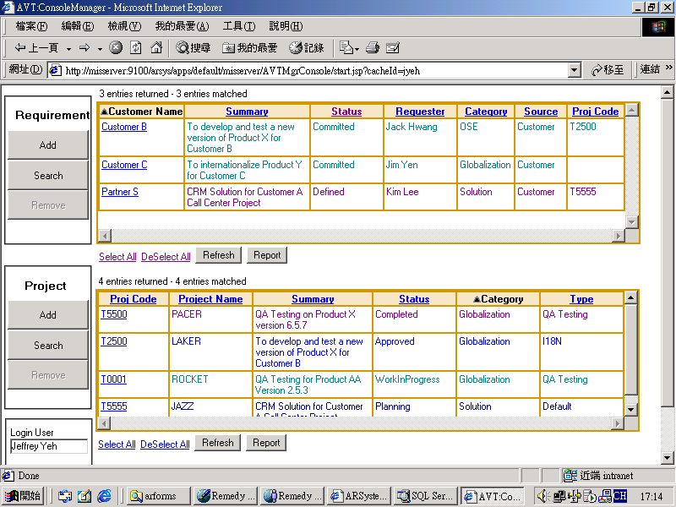
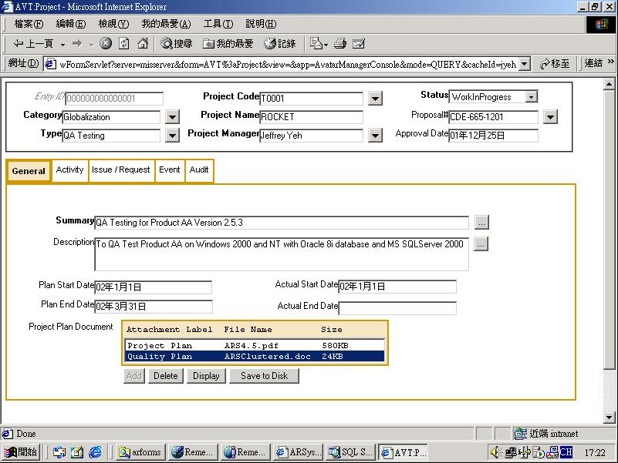
MANAGING DISTRIBUTED TEAMS
Avatar Management System
Process
Technology
People

Slide 21
MANAGING DISTRIBUTED TEAMS
Evolution of Teams
Process
Increased Communication Challenges
Technology
People
Stage 1:
One location
Stage 2:
Centralized coordination
Stage 3:
Globally integrated
HQ
HQ
HQ
Source: Erran Carmel. Global Software Teams: Collaborating Across Borders and Time Zones, Upper Saddle River, NJ: Prentice Hall, 1999

Slide 22






MANAGING DISTRIBUTED TEAMS
Project Team Design
Process
Methodology
Executive Management
Technology
People
Development
Technology & Support
Globalization
Individual Roles:
Project Manager
Program Manager
Product Specialist
Committees:
Project Management
Technical Oversight
Project Process
Internationalization
Project Office
Localization
QA & Testing

Slide 23
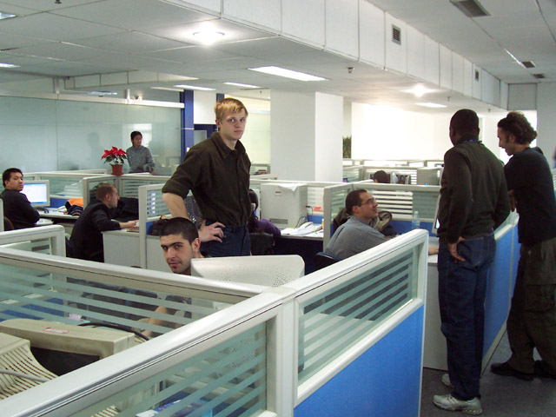
MANAGING DISTRIBUTED TEAMS
Culture and Interaction Are Related
Process
A Real Team
  Perceived to be a team by its members
  Recognized as a team by non-members
  Shares collective responsibility for its work
  Shares responsibility for managing its work
  Has common set of goals or tasks
  Works together on tasks that are interdependent
  Shares its rewards
Technology
People
Notes:
Team culture and team interaction are closely related

Slide 24



MANAGING DISTRIBUTED TEAMS
Trust Is Essential
Building Trust
  Role legitimization
  Open information access for all team members
  Designate team cheerleaders/liaisons
  Schedule face-to-face meetings into the lifecycle
Process
Technology
People
Completion
Milestone
Trust
Milestone
Kick-off
Milestone
Time
Notes:
Trust is an essential ingredient that needs continual reinforcement

Slide 25
MANAGING DISTRIBUTED TEAMS
Cultural & Distance Issues
Think In “Shifts”, not Time Zones
Formalized Communication Protocols
Process
Technology
People
Response Times | Email within 1 business day Voicemail within 6 hours Define priority levels & response times
Frequency | Regularly scheduled meetings Regularly scheduled reports
Awareness | Post time zones/shifts Reporting into knowledge base
Escalation | Support mechanisms for communication breakdown Liaisons for troubled interactions
Notes:
Distributed teams need to be conditioned for cultural and distance issues

Slide 26
MANAGING DISTRIBUTED TEAMS
Active Socialization Builds Team Culture
Process
Maintain Small, Intimate Teams
  Lateral communication links grow geometrically
Help Each Team See Itself as a Unit
  Teams “belong” to certain managers
  Encourage teams to give themselves a name
Encourage / Create
  Atmosphere where shared rituals, stories, symbols and language can emerge
  Encourage informal communication
  Encourage “inside” stories
  Allow for team-specific jargon
  Allow discussions to go “off the beaten path” – to a degree
Technology
People
Notes:
Creating a common team culture requires active socialization

Slide 27
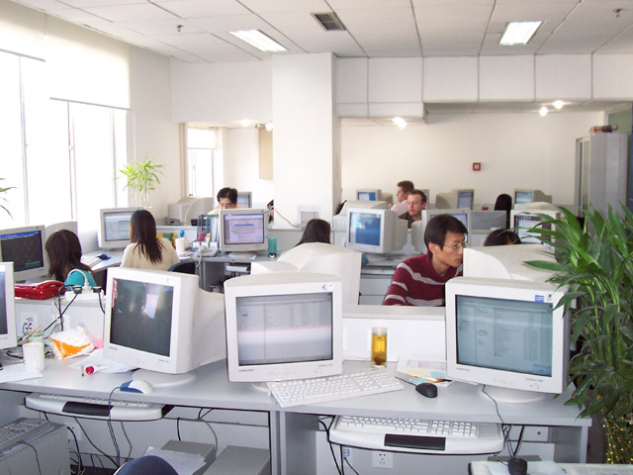
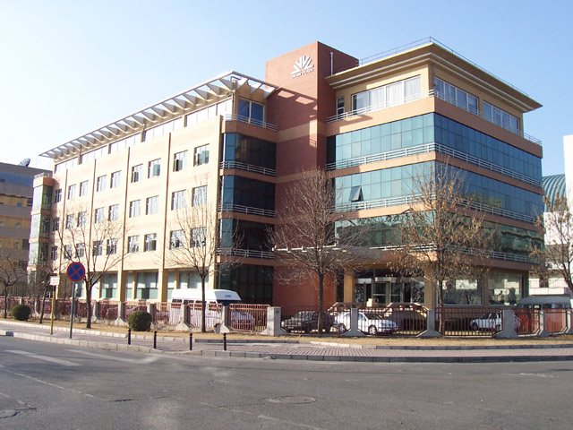
COMPANY OVERVIEW
Symbio Beijing
View within a dedicated client lab. Access to this lab is restricted only to team members and client-designated staff. Note that Symbio’s Beijing team also includes non-Chinese staff to work with clients around the world. Our staff in Beijing speaks over 40 different languages.
View of Symbio’s main Beijing development center from outside – Symbio occupies the entire 3rd and 4th floors in the building, as well as another facility in the building next door. IBM’s Beijing R&D lab is to our building’s left, and Lenovo’s HQ is to our right

Slide 28


STPCON 2006
Conclusions
Challenges Exist
  They can be overcome
Focus On:
  Process
  Technology
  People
Manage Cultural Issues Aggressively
Look for Ways to Build Trust
  Anticipate trust issues in early stages

Slide 29
QUESTIONS & COMMENTS:
CONTACT INFORMATION
Dean Stevens
VP of Marketing
The Symbio Group
Main: +1 425-378-0885
Mobile: +1 408-482-6930
dean.stevens@symbio-group.com
www.symbio-group.com

